Slide 1

Unit 2
I think that mooncakes are
delicious!
Section B 2a-2e

Slide 2













What do you know about Christmas?

Slide 3
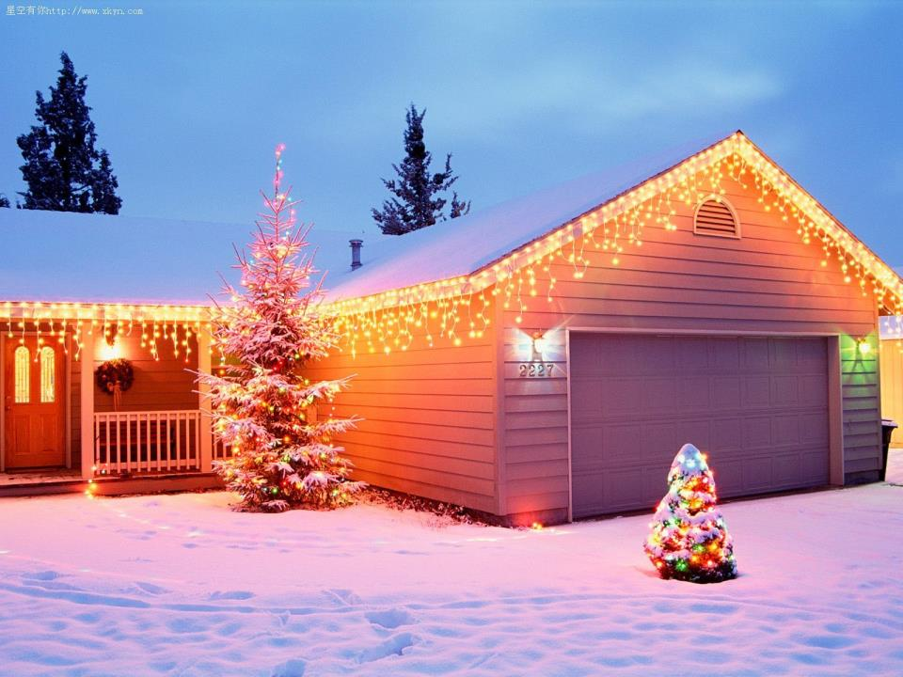
每年12月25日，这一天基督徒纪念耶稣的诞生，为圣诞节而闻名。

Slide 4

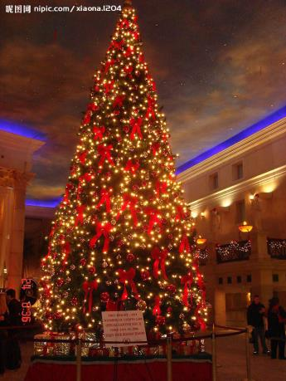
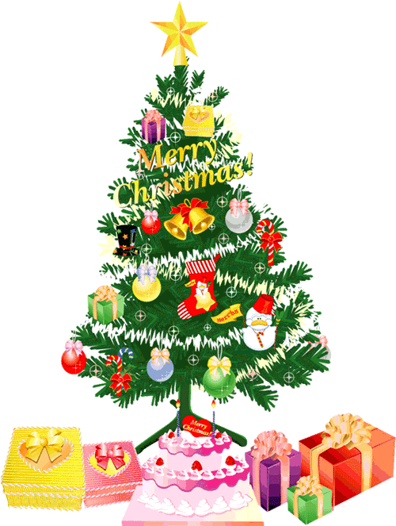
Christmas tree
PPT模板：www.1ppt.com/moban/ PPT素材：www.1ppt.com/sucai/
PPT背景：www.1ppt.com/beijing/ PPT图表：www.1ppt.com/tubiao/
PPT下载：www.1ppt.com/xiazai/ PPT教程： www.1ppt.com/powerpoint/
资料下载：www.1ppt.com/ziliao/ 范文下载：www.1ppt.com/fanwen/
试卷下载：www.1ppt.com/shiti/ 教案下载：www.1ppt.com/jiaoan/
PPT论坛：www.1ppt.cn PPT课件：www.1ppt.com/kejian/
语文课件：www.1ppt.com/kejian/yuwen/ 数学课件：www.1ppt.com/kejian/shuxue/
英语课件：www.1ppt.com/kejian/yingyu/ 美术课件：www.1ppt.com/kejian/meishu/
科学课件：www.1ppt.com/kejian/kexue/ 物理课件：www.1ppt.com/kejian/wuli/
化学课件：www.1ppt.com/kejian/huaxue/ 生物课件：www.1ppt.com/kejian/shengwu/
地理课件：www.1ppt.com/kejian/dili/ 历史课件：www.1ppt.com/kejian/lishi/
Notes:
PPT模板：www.1ppt.com/moban/ PPT素材：www.1ppt.com/sucai/
PPT背景：www.1ppt.com/beijing/ PPT图表：www.1ppt.com/tubiao/
PPT下载：www.1ppt.com/xiazai/ PPT教程： www.1ppt.com/powerpoint/
资料下载：www.1ppt.com/ziliao/ 范文下载：www.1ppt.com/fanwen/
试卷下载：www.1ppt.com/shiti/ 教案下载：www.1ppt.com/jiaoan/
PPT论坛：www.1ppt.cn PPT课件：www.1ppt.com/kejian/
语文课件：www.1ppt.com/kejian/yuwen/ 数学课件：www.1ppt.com/kejian/shuxue/
英语课件：www.1ppt.com/kejian/yingyu/ 美术课件：www.1ppt.com/kejian/meishu/
科学课件：www.1ppt.com/kejian/kexue/ 物理课件：www.1ppt.com/kejian/wuli/
化学课件：www.1ppt.com/kejian/huaxue/ 生物课件：www.1ppt.com/kejian/shengwu/
地理课件：www.1ppt.com/kejian/dili/ 历史课件：www.1ppt.com/kejian/lishi/

Slide 5
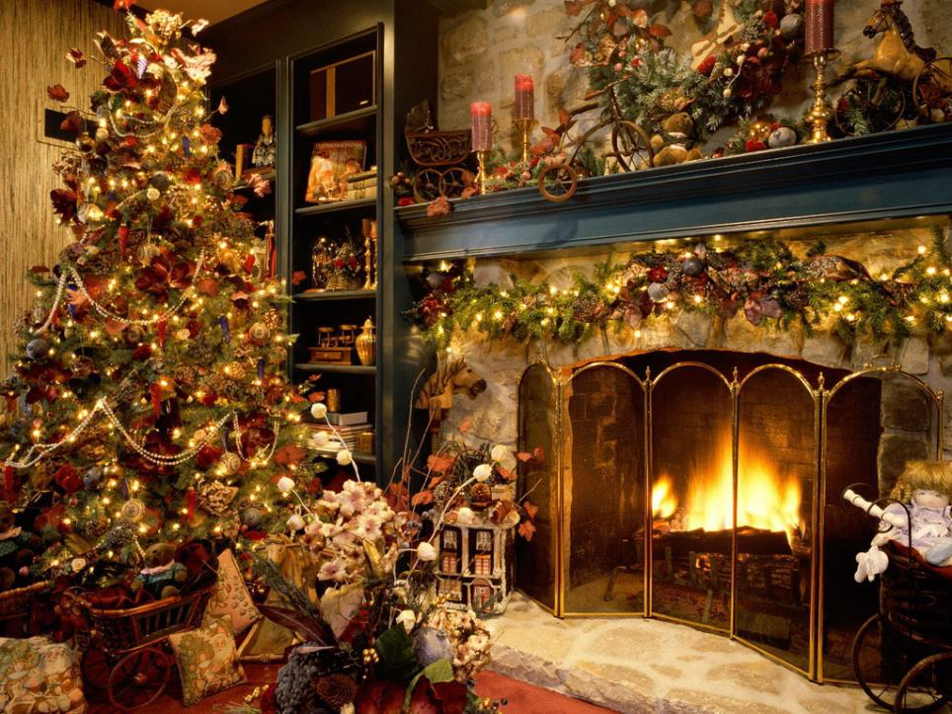

Slide 6
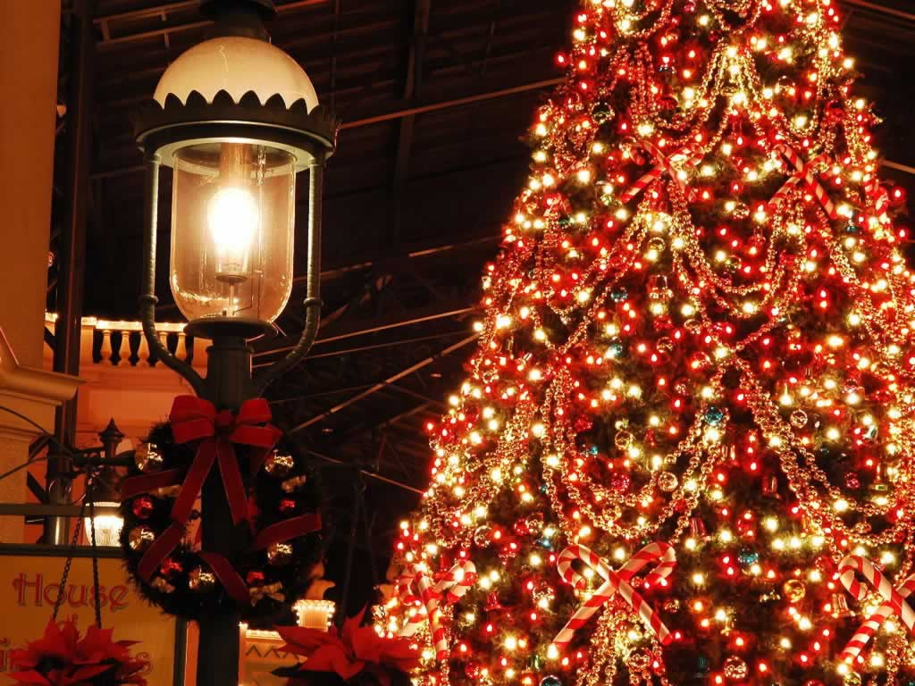

Slide 7
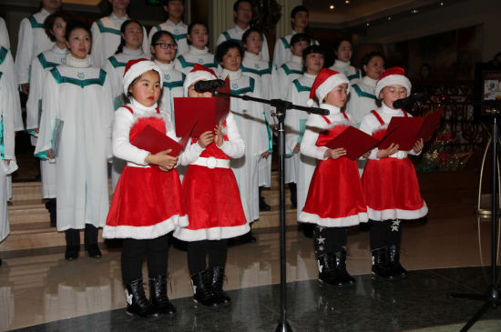
Christmas carol
圣诞节赞美诗

Slide 8
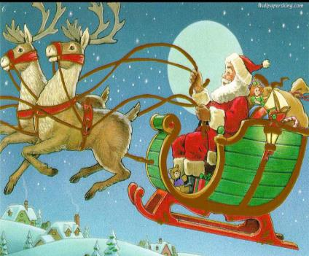
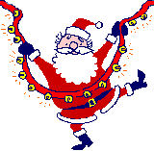
Christmas Claus

Slide 9
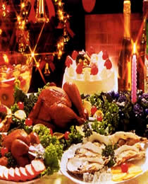

Christmas dinner

Slide 10
2a What do you know about Christmas? Discuss in groups and create a mind map.
Activities
Christmas
Date
Stories
Symbols

Slide 11
Date:
December 25th
Christmas tress, Santa Claus, gifts, stockings
sing Christmas songs, make Christmas trees, family gathering, get a lot of presents
…
Symbols:
Activities:
Stories:

Slide 12
2b Read the passage about Christmas and answer the questions.
INFERRING
This means you have to “read between the lines” to get the meanings that are not clearly stated in a text.

Slide 13
The Spirit of Christmas
Many would agree that when we think of
Christmas, we probably think of gifts,
Christmas trees and Santa Claus. But behind
all these things lies the true meaning of
Christmas: the importance of sharing and giving love and joy to people around us. The story in A Christmas Carol is perhaps the best example of this.

Slide 14
A Christmas Carol is a famous novel written by Charles Dickens. It is about an old man named Scrooge who never laughs or smiles. He is mean and only thinks about himself. He doesn’t treat others nicely. He just cares about whether he can make more money and he hates Christmas. One Christmas Eve, Scrooge sees the ghost of Jacob Marley, his dead business partner. Marley used to be just like Scrooge,

Slide 15
so he was punished after he died. He warns Scrooge to change his ways if he doesn’t want to end up like him. He also tells Scrooge to expect three spirits to visit him.
That night, three ghosts visit Scrooge. First, the Ghost of Christmas Past takes him back to his childhood and reminds Scrooge of his happier days as a child. Then the second spirit, the Ghost of Christmas Present, takes him to see how others are spending Christmas this year.

Slide 16
Everyone is happy, even poor people. The last one, the Ghost of Christmas Yet to Come, takes him to the future. Scrooge sees that he is dead, but nobody cares. He is so scared that he wakes up in his bed and finds out it is only the next morning --- Christmas Day!
He decides to change his life and promises to be a better person. He happily celebrates Christmas with his relatives. He also gives
gifts to people in need.

Slide 17
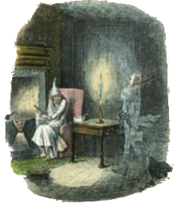

He now treats everyone with kindness and warmth, spreading love and joy everywhere he goes. And that is the true spirit of Christmas!

Slide 18
Answer the questions.
What are the common things that people
think of for Christmas?
2. Who wrote A Christmas Carol?
3. What is the true meaning or spirit of
Christmas?
Gifts, Christmas trees and Santa Claus.
Charles Dickens.
The importance of sharing and giving love
and joy to people around us.

Slide 19
Language Points
But behind all these things lies the true
meaning of Christmas: the importance of
sharing and giving love and joy to people
around us. 但是在这一切背后存在着圣诞节
的真谛: 分享与给予我们周围的人爱与欢乐
的重要性。
（1）lie v. 意为“存在；在于”，主要指思想、
特征问题等。
► The problem lies in their method.
问题在于他们的方式。

Slide 20
（2）share v. 意为“分享；分担”，常与with, among, between, in 连用。
► I share my lunch with him.
我与他分享我的午餐。
► We share a small room between us.
我们俩合用一个小房间。
► They share (in) the joy and sorrows .
他们将同甘共苦。

Slide 21
2. A Christmas Carol is a famous short novel written by Charles Dickens.《圣诞颂歌》是查尔斯•狄更斯的著名短篇小说。
(1)famous形容词，意为“著名的；出名的”， 既可以作表语，也可以作定语。其同义词是 well-known，反义词为 unknown。
►Thomas Edison is a famous scientist.
托马斯•爱迪生是一位著名的科学家。

Slide 22
①be famous for…“因......而著名/出名”
►China is famous for the Great Wall.
中国因长城而闻名。
②be famous as…“作为......而出名’’。
►Liu Huan is famous as a singer.
刘欢作为一名歌手而出名。
(2) written是write的过去分词，此处writte 是过去分词作后置定语，修饰名词nove1。
►I like the novels written by Mo Yan.

Slide 23
3. He is mean and only thinks about himself.
他吝啬，只考虑自己。
mean 用作形容词，意为“吝啬的，刻薄的”
► Don’t be so mean to your little brother.
别对你弟弟那么刻薄。
mean作动词，意为“意味着;作......解释.......
的意思”。

Slide 24
其名词形式是meaning (意思；含 义），常构
成短语the meaning of…，意为“......的意思”。
►It means that your answer is right.
那意味着你的答案是正确的。
►What does this word mean?
=What’s the meaning of this word?
这个单词是什么意思？

Slide 25
4. He just cares about whether he can make
more money and he hates Christmas.
他只关心能否挣到更多的钱，且厌恶圣诞节。
(l) care about意为“担心; 关心；在乎；对…
感兴趣”
►Don’t you care about losing your job?
你难道不担心失去工作吗？
►I really care about the students in my class.
我真的很关心我班的学生。
►I don’t care about your opinion.
我对你的观点不感兴趣。

Slide 26

辨析：care about 和 care for
care about: 意为“关心；在乎；介意”，强调
出于责任感而“关心；在乎”
care for: 意为“照料；照賴”，与take care
of 同义;另一个意思为“喜欢”，
多用于疑问句和否定句，其同义
短语为 be fond of。

Slide 27
►My parents care about my health.
我父母关心我的健康。
►Would you care for a cup of tea?
你想喝杯茶吗？
(2) hate作动词，意为“憎恨;讨厌;厌恶”，不 能用于进行时，其反义词是love。常用短
hate sb/ sth; hate to do sth 或hate doing sth.
► I like swimming but I hate to swim today.
► I enjoy cooking but hate doing the dishes.

Slide 28
5. Marley used to be just like Scrooge, so she was punished after he died.
马利过去曾经就像斯克鲁奇一样，所以在死后受到了惩罚。
(l) used to意为“过去常常”，后接动词原形， 表示过去的动作或状态。
►He used to play basketball at school.
他过去常在学校打篮球。
►I used to be short. 我过去很矮。

Slide 29
(2) was punished意为“被惩罚”，此结构为一
般过去时的被动语态。一般过去时的被动 语态的结构为“was/were+及物动词的过去分词”。
► The house was built in 1969.
这座房子建于1969年。
►These trees were planted last year.
这些树是去年种的。

Slide 30
6. He warns Scrooge to change his ways if he
doesn’t want to end up like him.
他告诫斯克鲁奇，如果他不想走上自己的老路，就要改变生活方式。
(l) warn作动词，意为“警告；告诚”，常用于以下结构：
① warn sb. (not) to do sth，意为“告诚某人 (不要)做某事”。

Slide 31
► He warned her to keep silent.
他告诫她保持沉默。
②warn sb. about sth，意为“提醒某人注意某事”。
►She warned us about the serious situatio.
她提醒我们注意形势的严峻性。
③warn sb. of/against (doing) sth，意为“
告诫某人当心/提防(做)某事”。
► They warned me against swimming in that
part of the river.

Slide 32
他们告诫我不要在河的那一带游泳。
(2) end up意为“最终成为; 最后处于；结 束”，其后可以跟with，in，doing等：
① end up with表示“以……结束”，其后可跟
任何名词。
►If you do that, you’ll end up with egg on your
face. 你要是那样做，必将出洋相。

Slide 33
② end up in后面一般要接一个地点名词。
►If you continue to steal, you’ll end up in
prison. 你要是继续行窃，早晚得进监狱。
③ end up doing表示“以做……结束”，此处
词-ing形式作宾语。
►The party ended up singing an English song.
晚会以唱一首英文歌而结束。

Slide 34
2c Read the passage again and complete the chart.
What does Scrooge see when he’s with ...
the Ghost of Christmas Past?
the Ghost of Christmas Present?
the Ghost of Christmas Yet to Come?
His childhood.
How others are spending Christmas this year.
He is dead, but
nobody cares.

Slide 35
2d Answer the questions. Some answers need to be inferred.
1.Why does Scrooge hate Christmas?
Does Scrooge have a lot of friends?
Why or why not?
Because he is mean and only thinks
about himself.
No, he doesn’t. because he doesn’t treat
others nicely.

Slide 36
3. Why was Jacob Marley punished after
he died?
Because he used to be just like Scrooge.
4. Does Jacob Marley want to help
Scrooge? How do you know?
Yes, he does. He warns Scrooge to change his ways if he doesn’t want to end up like him.

Slide 37
5. How does Scrooge feel when he wakes up on Christmas Day?
6. What does Scrooge do after seeing the
three spirits?
He is so scared.
He happily celebrates Christmas with his
relatives and gives gifts to people in need.

Slide 38
2e What do you think the three ghosts say to Scrooge when they visit him? In groups of four, make a conversation
between the three ghosts and Scrooge. Role-play the conversation in front of the class.

Slide 39


Pair Work
What do you know about Christmas? Make a list of things that you know about this festival with your group. Use the questions to help you.

Slide 40
When is this festival?
Why do people celebrate it?
Who do they celebrate it with?
Do they eat or drink anything special?
What other things do they do as part of
the celebrations?
Do you know any old stories about this festival?
How do people feel when they celebrate it?

Slide 41

自我练习

Slide 42
Choose the right answers
1.--Could you tell me how long __ the book?
--Three days.
A. I can keep B. Can I borrow
C. I can borrow D. Can I keep
2. I want to know ___ yesterday?
A. why did you come late
B. why you came late
C. why do you come late.
D. why you come late

Slide 43
3.--Could you tell me __ tomorrow morning?
--Well, it will start at 9:00.
A. when the meeting will start
B. where will the meeting start
C. where the meeting start
D. when will the meeting start

Slide 44
4. Can you tell me ?
A. what will we do
B. we will do what
C. what we will do
D. will we do what
5.—Do you know ___ for Shanghai last night?
--- At 9:00.
what time he leaves
What time does he leave
C. What time he left
D. What time did he leave

Slide 45
Translate
1.我想知道你喜欢什么颜色
I want to know what colour you like.
2.你能告诉我你住哪里吗？
Can you tell me where you live?
3.玛丽想知道你能否帮她？
Mary wants to know if you can help her.

Slide 46
4. Danny说他明天出发去上海。
Danny says that he will leave for Shanghai tomorrow.
5.我想汤姆已经完成作业了。
I think that Tom has finished his homework.

Slide 47
Homework
Search more information about Christmas
And other foreign festivals. Then play a
game to speak them out.

Slide 48
Thank You!

